Slide 1
Engaging & Inspiring Learning Everyday using
DE Resources
Created by:
Rita Mortenson
Lisette Venegas
Find Out What Can Happen When You Step Out of the Box Using DE Resources

Slide 2
VFT Planning Guide
See what can happen when you step out of the box and use DE for more than just the videos! This slideshow walks through how to plan a collaborative VFT that can engage students (of all ages) and support educators across sites.

Slide 3
More than
Virtual Field Trips
Notes:
Rita - not just VFT

Slide 4
Thinking Outside the Box
When you let your creativity soar, anything is possible with DE resources!
Notes:
Rita - You might be wondering what this gift box is? Anytime you see it we will be explaining how we thought outside the box!

Slide 5
Thinking Outside of the Box
DE resources can create some really magical moments for our students.
These events started out with VFTs, but after increased interest from teachers and students, it was clear these opportunities could be done with other DE resources.
Notes:
Rita

Slide 6
Thinking Outside of the Box
This presentation will walk through how transportation, planning, collaboration, strategies, Studio boards, and making connections are ways to challenge yourselves to think out of the box.
Notes:
Rita

Slide 7
Mixing the ReSources
VFT
SOS
Videos
Podcasts
Students
Studio Board
Pick a VFT
Engage students with SOS Strategies
So many to choose from
Invite high school students for elementary or middle school students
Duplicate the Studio Board or use “As is”
Notes:
Rita

Slide 8
Incredible Engagement
Engaging & Inspiring Learning Everyday
Notes:
Lisette
What did we experience from doing this? Incredible engagement! They ate it up!

Slide 9
Planning
Connect to the curriculum
Select a topic and resources
Partner up with different grade levels
Find common time in schedules and a connection to the content
As events grow, invite the press, district leadership, PTO, or Community
Notes:
Lisette

Slide 10
Planning
Things to keep in mind:
Check what your district will require:
Field Trip forms, Media release forms, etc.
Transportation
See if you have existing transportation you can leverage and try to plan around that
Schedules
Find common time in the two school schedules
Notes:
Lisette

Slide 11
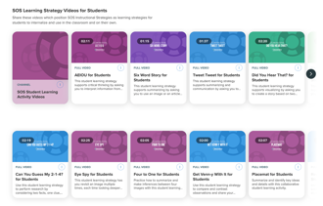
SOS Strategies
Try using SOS strategies with the content to make it engaging! Some of our favorites:
Six word story
Music playlist
Notes:
Lisette

Slide 12
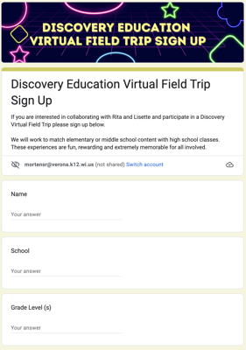
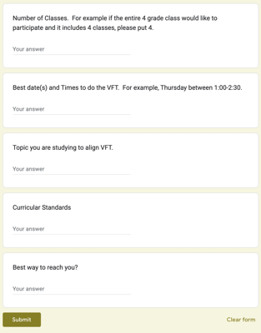
Planning Document
As interest increases, consider using a Google form to organize sign ups. For now, use these questions to guide your planning!
Notes:
Lisette

Slide 13
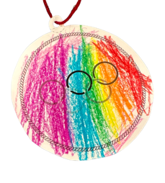
Day Of
Older students are the teachers!
Showcase the DE Video and make connections
Complete some stations to showcase learning
Provide the venue for the students and staff to shine
Have FUN!
Notes:
Lisette

Slide 14
Follow Up
Share
THank you
newsletter
Article
Post on Social Media
Thank the teachers and the student presenters
Share photos and/or a newsletter with all that participated
Send an article to the local newspaper
Notes:
Rita

Slide 15
Post-Event
Share your success!
Create a Newsletter
Create Social Media Posts (Facebook, Twitter, etc.)
Share with School Administrators
Share in DEN Friends
Create an update for the School Website
Connect with the Local Paper
Notes:
Rita

Slide 16
The Power of the DEN
Don’t forget about our amazing network with DEN Friends. We try to post ideas for others to see.
My goal this year is to showcase and share more neat ways we are using DE in the classroom.
Notes:
Rita

Slide 17
Have Fun!
CREDITS: This presentation template was created by Slidesgo, including icons by Flaticon, and infographics & images by Freepik.

